Slide 1
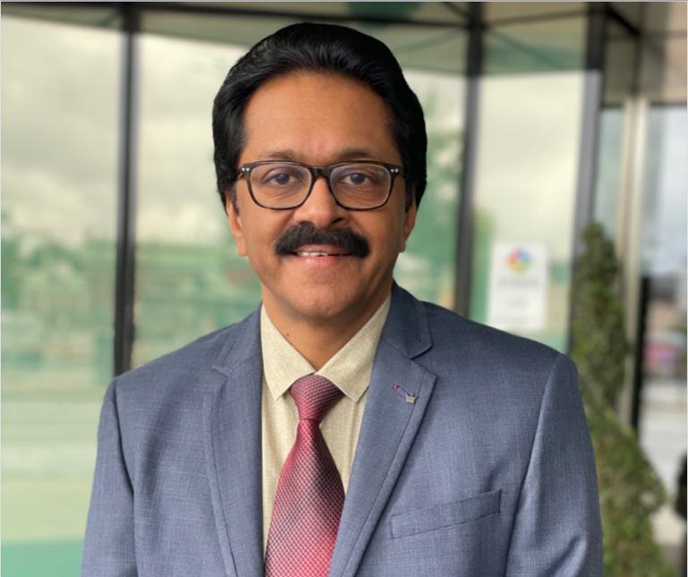
  Chairman, Jothydev’s Diabetes Research Centers, Trivandrum, Kochi, Attingal, Haripad
  Central Executive Committee member RSSDI and AIAARO
  National President, Diabetes Technology Trust of India
  Organizing Chairperson: JPEF Annual Conventions
  Managing Trustee, P.Kesavadev Trust –engaged in charity and literary activities
  Editor in Chief, International Journal of Diabetes and Technology
  Conducts monthly diabetes education via 2 YouTube channels.(jothydev, kesavadev trust)
  Publishes a monthly internet based free diabetes newsletter for the past 15 years
  More than 300 publications in indexed scientific journals and chapters in textbooks
  Pioneer in cost effective treatment of diabetes with use of telemedicine and technology
  JDC is an IDF recognized Centre of Excellence in Diabetes Care and Centre of Education
  JDC is accredited for RSSDI certified course in diabetology for doctors
JOTHYDEV KESAVADEV
MD,FRCP(London, Glasg,Edin), FACP,FACE,FRSSDI

